Slide 1
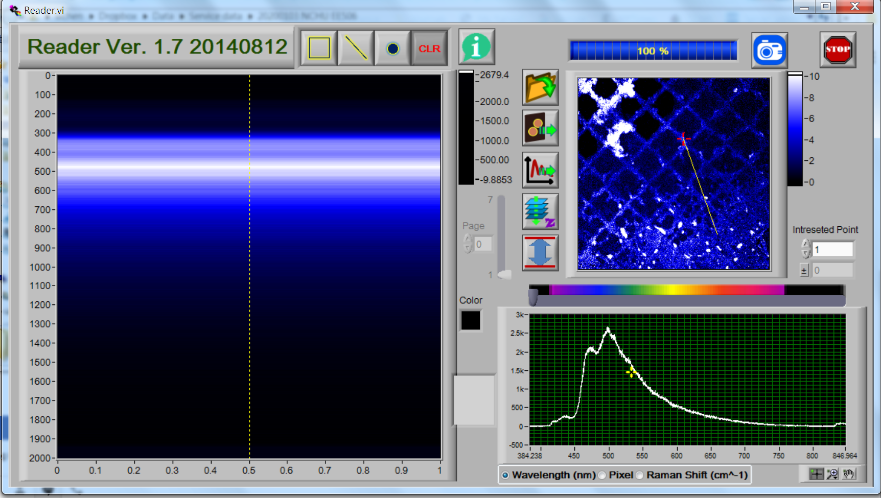
Open file
Export ASCII file

